Slide 1




Beyond outliers and on to micro-clusters: Vision-guided Anomaly Detection
Wenjie Feng⁺ Shenghua Liu⁺ Christos Faloutsos*
Bryan Hooi* Huawei Shen⁺ Xueqi Cheng⁺
⁺Institute of Computing Technology ICT, CAS
University of Chines Academy of Sciences, UCAS
*Computer Science Dept., Carnegie Mellon University
Supported by PAKDD Steering Committee Student Travel Grant

Slide 2
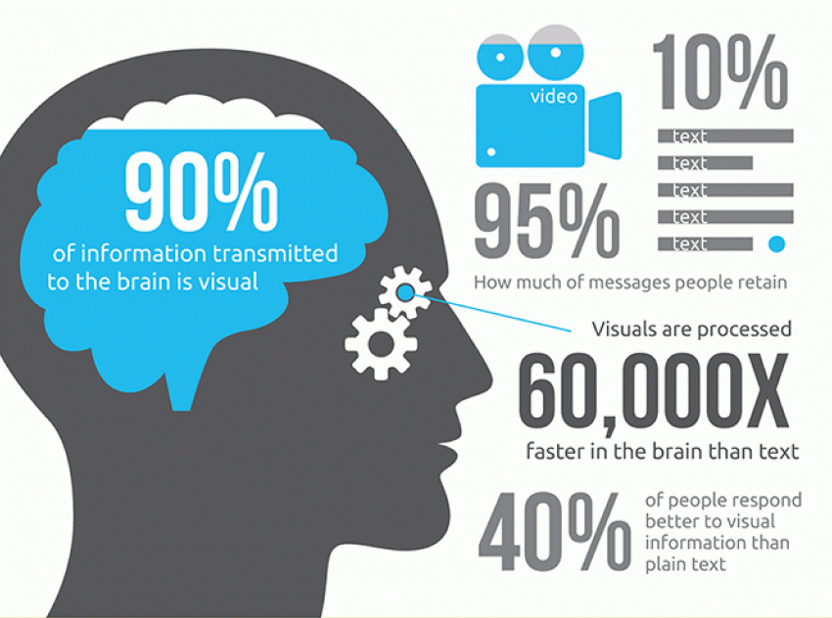
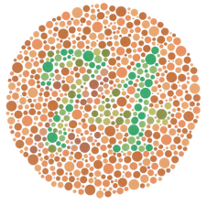


Motivation: Vision Diagnosis
Vision recognition
[vmistudio]
[Color blind test]
[Bylinskii Z. et al, 17]

Slide 3
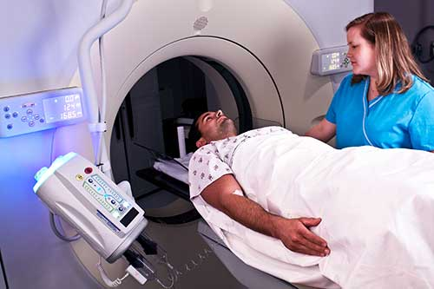
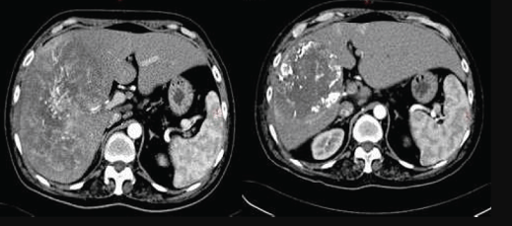
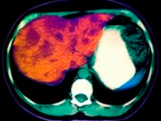
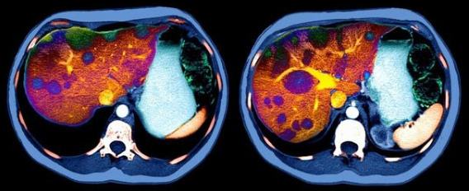
Motivation: Vision Diagnosis
Vision recognition
Application
[vmistudio]
[Color blind test]
[Bylinskii Z. et al, 17]
Health care
Chest CT
Cancer / Tumor

Slide 4
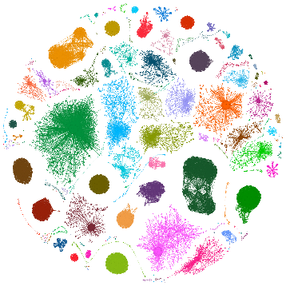
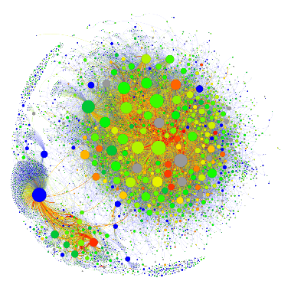
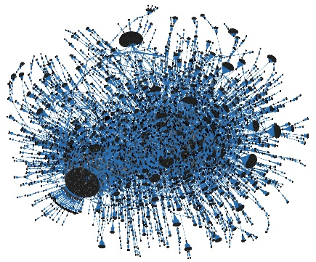



Motivation: Graph Diagnosis
Large scale graph, even evolving
[hashtag diffusion]

Slide 5



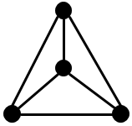
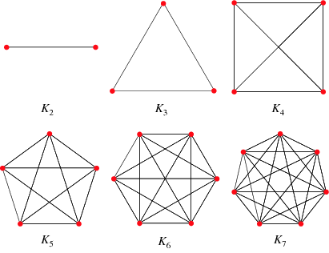



Motivation: Graph Diagnosis
Large scale graph, even evolving
Pattern detection E.g.
[hashtag diffusion]
Isolated clique
Review Fraud

Slide 6
Large Graph Diagnosis
Graph ‘CT’ scan views & micro-clusters
Nodes distribution in correlated feature spaces
E.g. (in/out) Degree, PageRank, #Triangle, Coreness, and Hubness / Authority, etc.

Slide 7
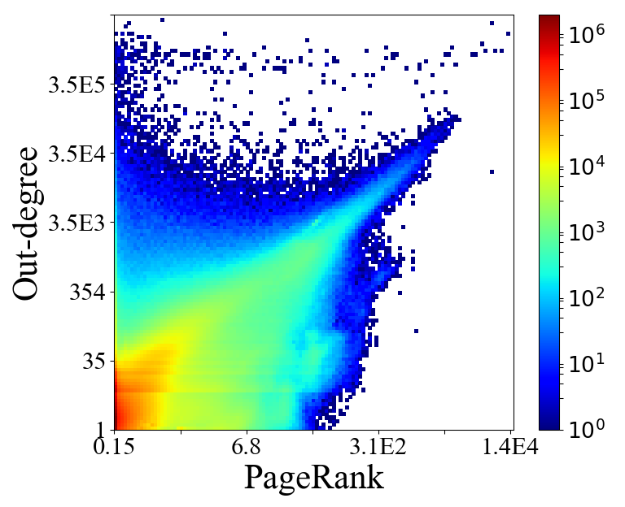
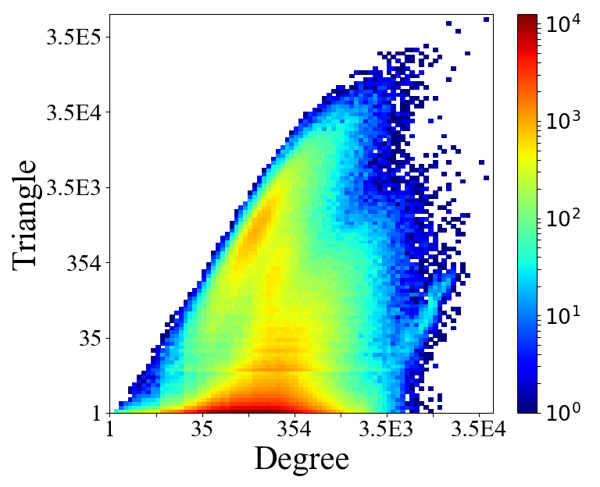
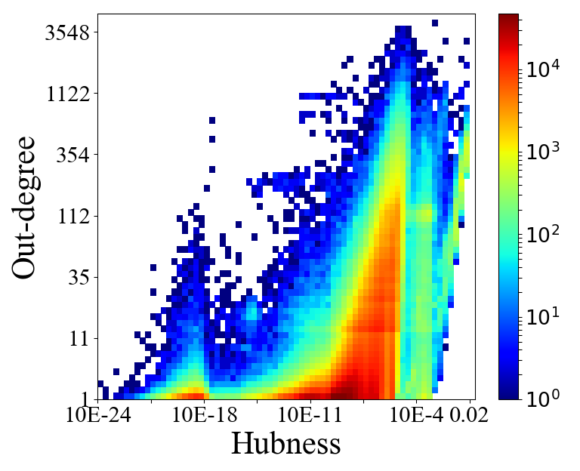



Large Graph Diagnosis
Graph ‘CT’ scan views & micro-clusters
Nodes distribution in correlated feature spaces
E.g. (in/out) Degree, PageRank, #Triangle, Coreness, and Hubness / Authority, etc.
[follow-ship]
[friendship]
[msg-retweet]
Two (or even high) dimension spaces

Slide 8

Research Question
Human vision system can quickly and accurately detect objects and deviations from normality.
Previous methods limitation (accuracy, scalability)
Clustering algorithm [STING, Watershed, HDBSCAN, etc.]
Community detection [Lancichinetti, A., et al, 09, etc.]
Dense sub-graph detection [M, jiang et al, 14, B. Hooi et al, 16]
Question:
How can we automatically detect patterns, separate anomalies, and summarize graph in a way similar to human vision does?

Slide 9


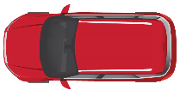
Road Map (Part-I)
Motivation
Proposed Method: EagleMine
Problem definition <<
Algorithm
Experiments
Extension
Conclusion

Slide 10
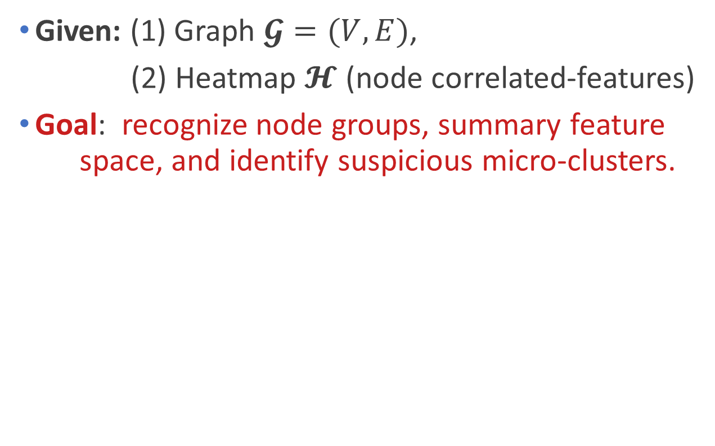
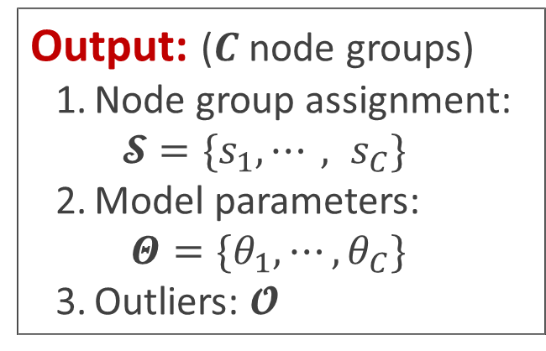
Problem Definition
Given: (1) Graph $𝓖=(V,E)$,
(2) Heatmap $𝓗$ (node correlated-features)
Goal: recognize node groups, summary feature space, and identify suspicious micro-clusters.
Output: ($C$ node groups)
Node group assignment: $𝓢=\{s_{1}, ⋯, s_{C}\}$
Model parameters: $Θ=\{θ_{1}, ⋯, θ_{C}\}$
Outliers: $𝓞$

Slide 11
Requirements
It is expected for the designed algorithm:
EagleMine, our proposed method, satisfies all the above requirements
Accurate: detects anomaly patterns accurately
Effective: provides intuitive and interpretable results for node groups
Automatic: provides a parameter-free feature summarization and vision-guided recognition
Fast: runs linearly w.r.t graph size
0

Slide 12
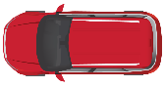
Road Map (Part-I)
Motivation
Proposed Method: EagleMine
Problem definition
Algorithm <<
Experiments
Extension
Conclusion

Slide 13

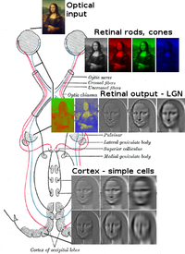
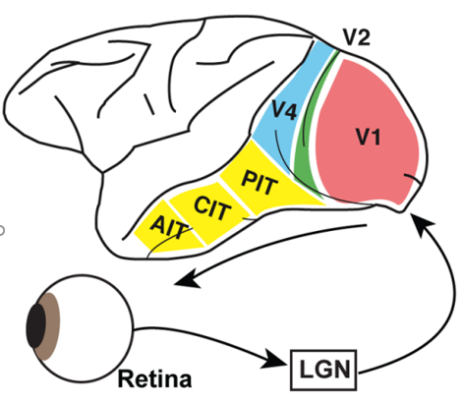
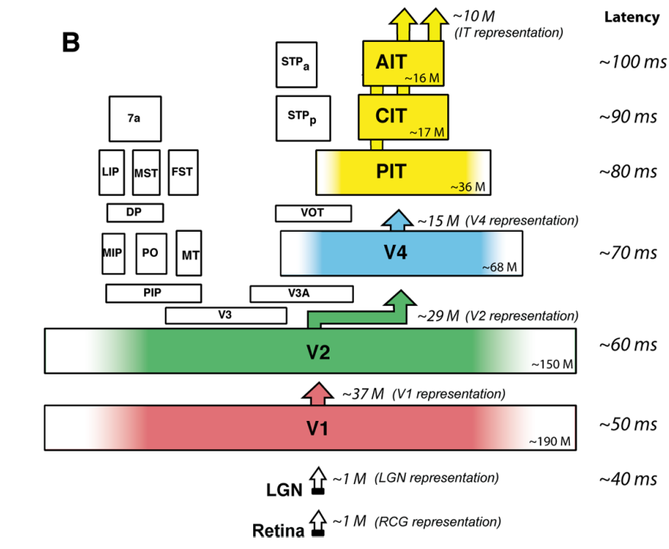
Bionics Consensus
Visual and Brain cognitive system
Top-to-bottom Recognition [DiCarlo, J. J. et al, 12, Heynckes, Miriam, 16]
Hierarchical info. Extraction & Organization [Arbelaez, P. et al, 11]
The ventral visual pathway
[DiCarlo, J. J. et al, 12]
Schema for optic tract
[Wikipedia]

Slide 14
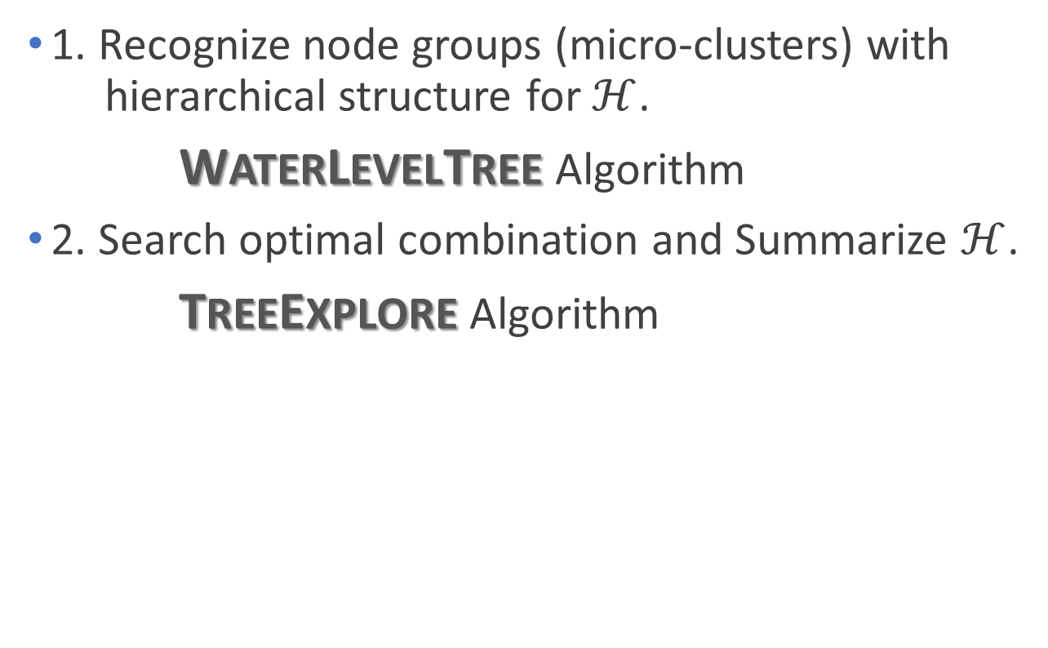
EagleMine Algorithm
1. Recognize node groups (micro-clusters) with hierarchical structure for $ℋ$.
WATERLEVELTREE Algorithm
2. Search optimal combination and Summarize $ℋ$.
TREEEXPLORE Algorithm

Slide 15
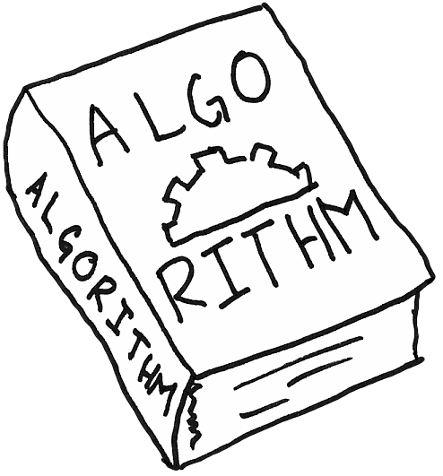
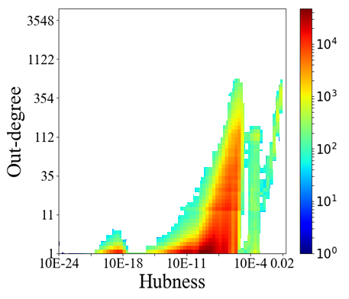
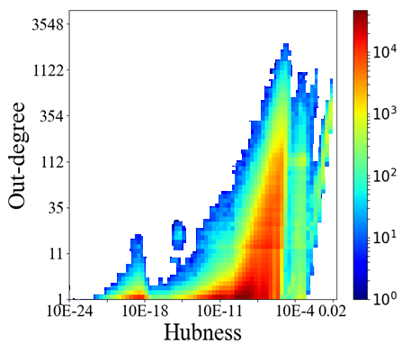

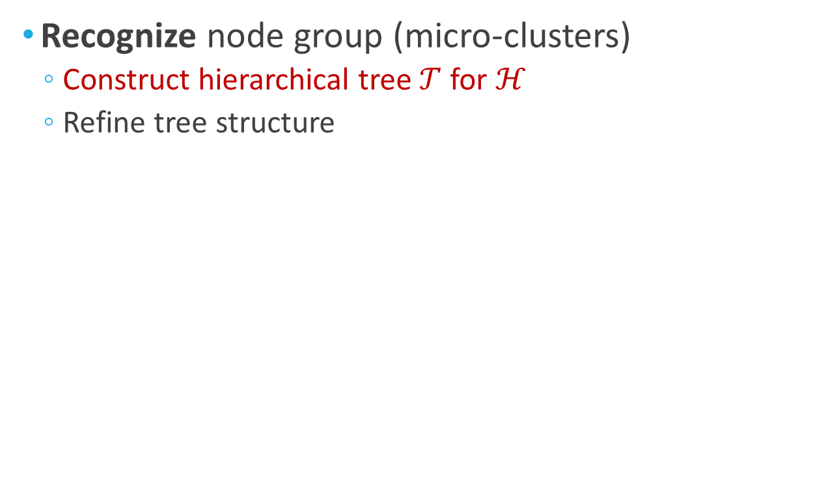
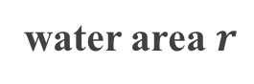
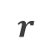


WATERLEVELTREE Algorithm
Details
Recognize node group (micro-clusters)
Construct hierarchical tree $𝒯$ for ℋ
Refine tree structure
……
……
new island
$$r$$
$$r$$
$$r$$
island
water area $r$

Slide 16
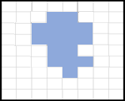
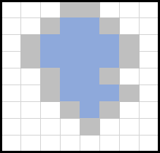

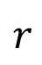
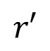
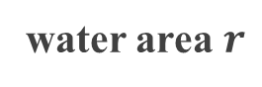
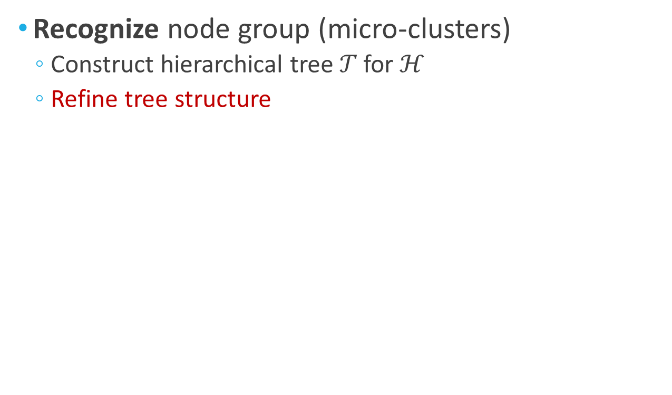
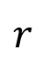
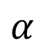
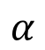
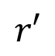
WATERLEVELTREE Algorithm (cont.)
Details
Recognize node group (micro-clusters)
Construct hierarchical tree 𝒯 for $ℋ$
Refine tree structure
……
Expand
$$α$$
new island
$$r$$
$$r′$$
Null
$$r′$$
Contract
$$r$$
$$α$$
island
Prune (smooth)
water area $r$

Slide 17

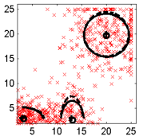
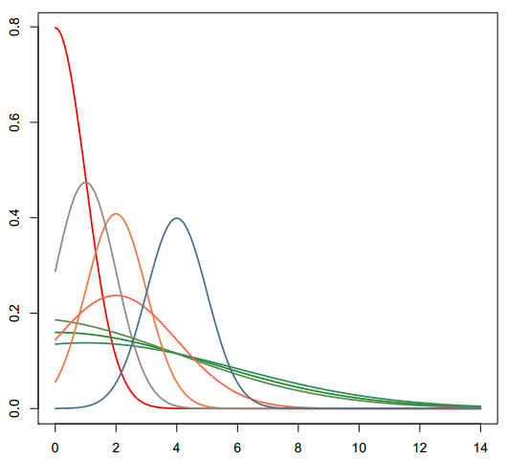
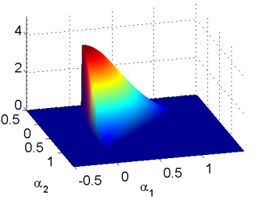
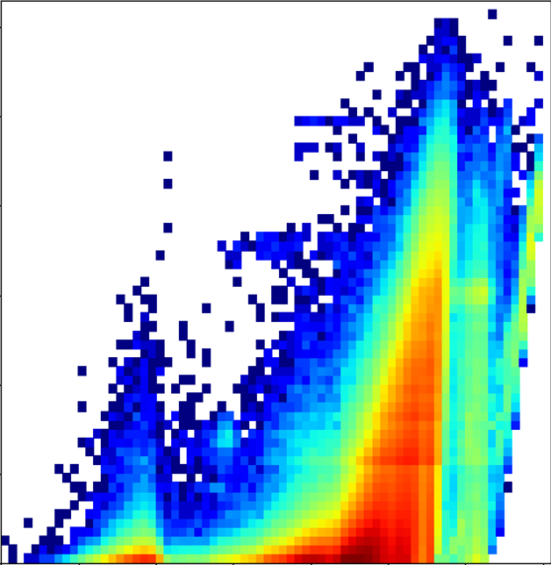
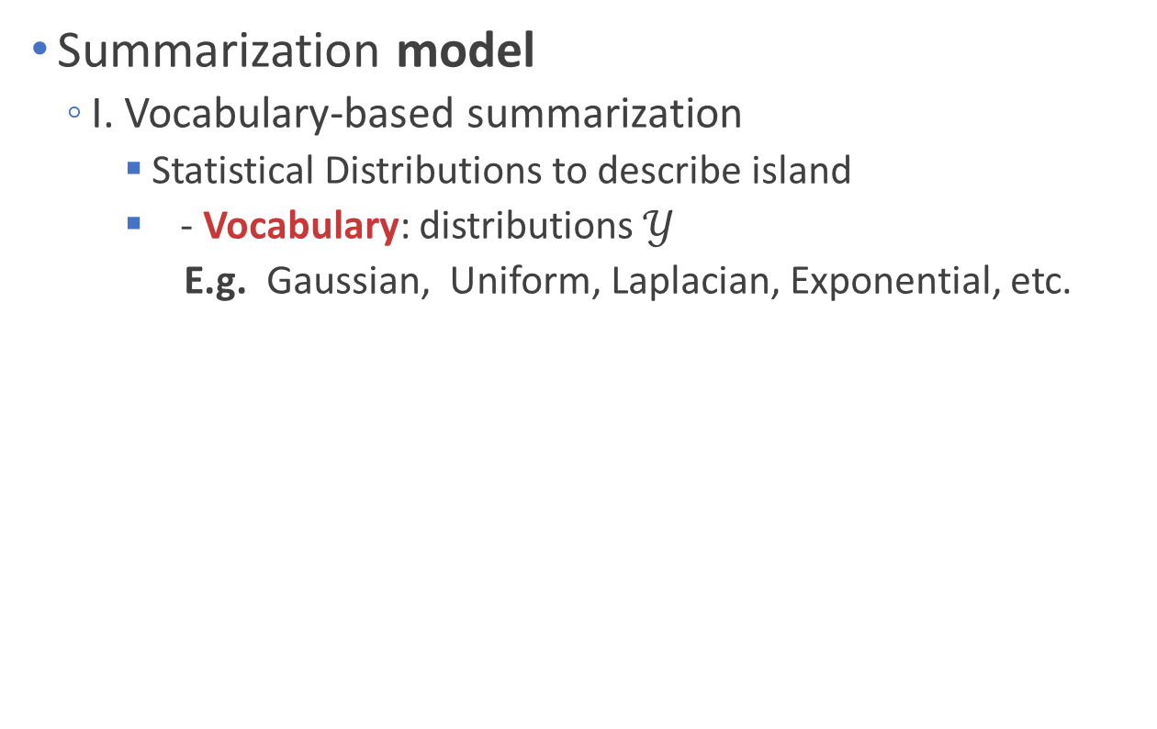
Summarization
Details
Summarization model
I. Vocabulary-based summarization
Statistical Distributions to describe island
- Vocabulary: distributions $𝒴$
E.g. Gaussian, Uniform, Laplacian, Exponential, etc.
Discretized, Truncated, Multivariate Gaussian (DTM Gaussian)

Slide 18
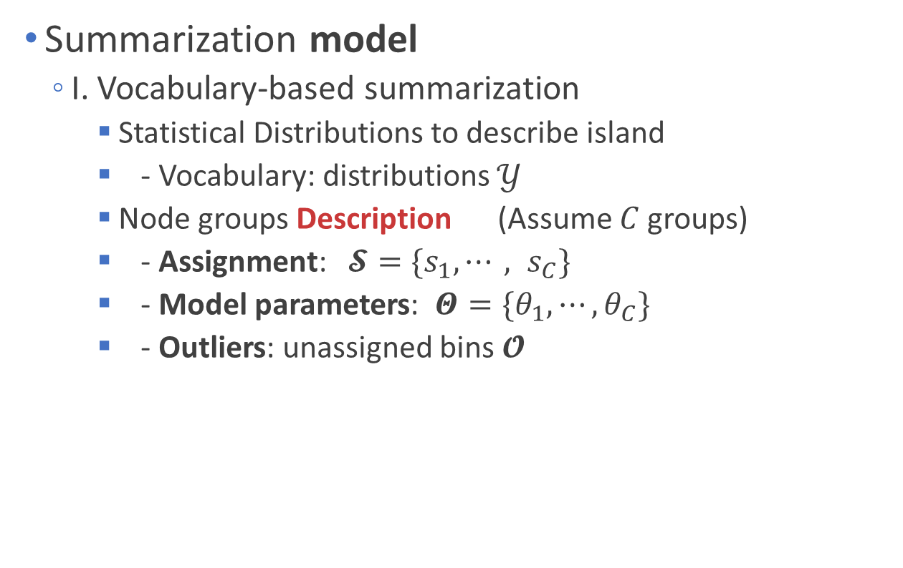
Summarization (cont.)
Details
Summarization model
I. Vocabulary-based summarization
Statistical Distributions to describe island
- Vocabulary: distributions $𝒴$
Node groups Description (Assume $C$ groups)
- Assignment: $𝓢=\{s_{1}, ⋯, s_{C}\}$
- Model parameters: $Θ=\{θ_{1}, ⋯, θ_{C}\}$
- Outliers: unassigned bins $𝓞$

Slide 19
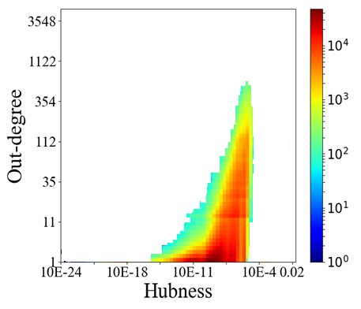
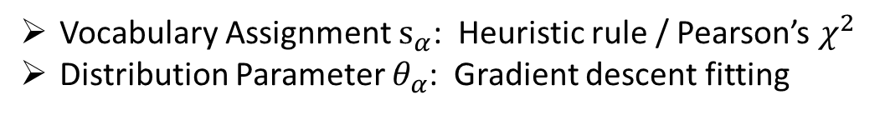
Summarization Algorithm
Details
Summarize node groups with a model
II. TREEEXPLORE Algorithm
BFS search
Determine the optimal node groups with Hypothesis Test
Stitch for enhancing
Mixture DTM Gaussian
reject
accept
Vocabulary Assignment $s_{α}$: Heuristic rule / Pearson’s $χ^{2}$
Distribution Parameter $θ_{α}$: Gradient descent fitting

Slide 20
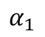
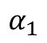
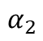
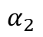
Summarization Algorithm (cont.)
Details
Summarize node groups with a model
II. TREEEXPLORE Algorithm
BFS search
Determine the optimal node groups with Hypothesis Test
Stitch for enhancing
$$α_{1}$$
$$α_{1}$$
$$α_{2}$$
stitch
$$α_{2}$$
Hypothesis Test

Slide 21



EagleMine Algorithm (cont.)
Details
Anomaly pattern detection
Identify suspicious micro-clusters
Suspiciousness metric:
weighted probability KL distance with the majority island
DTM Gaussian Description
Normal nodes (major island)

Slide 22

Road Map (Part-I)
Motivation
Proposed Method: EagleMine
Experiments <<
Conclusion

Slide 23

Real-world Graphs
Dataset statistics summary

Slide 24




Exp1. Anomaly Detection
Accuracy for synthetic and real-world anomalies
EagleMine captures micro-clusters besides dense subgraph
Injected fraud for real graph
Real Retweets data

Slide 25


Exp1. Anomaly Detection (cont.)
Anomaly patterns in real-graph
Jellyfish structure and Copy&Paste msg. in weibo data
Dense block detection [Fraudar, GetScoop, etc.]
77 users ->
50% C&P msg
Suspicious accounts 46% deleted
182x: “best*”
178x: “black*”
105x: “blue*”
51x: “coolboy*”
223x: “18-year-old*”
Jellyfish structure

Slide 26

Exp1. Anomaly Detection (cont.)
Anomaly patterns in real-graph
Near-clique and Star-like sub-graphs in Tagged data
Near-clique
too many #triangles for the degree
too few #triangles for the high degree
star-like
constellation

Slide 27

Exp1. Anomaly Detection (cont.)
EagleMine accurately detects injected fraud, spots suspicious user/msg and anomalous patterns in real data.
Accurate: detects anomaly pattern accurately
Effective: provides intuitive and interpretable results for node groups
Automatic: provides a parameter-free feature summarization and vision-guided recognition
Fast: runs linearly w.r.t graph size
0

Slide 28

Exp2. Effectiveness
Summarization quantitative metric: MDL
encoding model + encoding data with model + noise
the best model has shortest MDL
EagleMine achieves concise summarization for graphs

Slide 29







Exp2. Effectiveness (cont.)
Summarization qualitative: Consistency
Hubness vs. Out-degree
Gmeans
Xmeans
DBSCAN
Watershed
STING
EagleMine

Slide 30






Exp2. Effectiveness (cont.)
Summarization qualitative: Consistency
Authority vs. In-degree
treated as bkgd.
Watershed
Gmeans
Xmeans
STING
EagleMine

Slide 31







Exp2. Effectiveness (cont.)
Summarization qualitative: Consistency
Degree vs. #Triangle
Watershed
Xmeans
STING
DBCSCAN
EagleMine

Slide 32
Exp2. Effectiveness (cont.)
EagleMine achieves more concise summarization for the features heatmap, and finds more intuitive node groups.
Accurate: detects anomaly pattern accurately
Effective: provides intuitive and interpretable results for node groups
Automatic: provides a parameter-free feature summarization and vision-guided recognition
Fast: runs linearly w.r.t graph size
0

Slide 33



Exp3. Scalability Test
EagleMine’s time complexity
$h_{max}$: maximum of $ℋ$;
$ρ$: water-level step size;
$C$: $\#$node group;
$nnz$($ℋ$): $\#$none-zero values of $ℋ$;
$T$: $\#$iteration of learning;
Time vs. #node of graph

Slide 34
Exp3. Scalability Test (cont.)
EagleMine scales linearly with the number of nodes in graph.
Accurate: detects anomaly pattern accurately
Effective: provides intuitive and interpretable results for node groups
Automatic: provides a parameter-free feature summarization and vision-guided recognition
Fast: runs linearly w.r.t graph size
0

Slide 35


Road Map (Part-I)
Motivation
Proposed Method: EagleMine
Experiments
Conclusion <<

Slide 36





Conclusion
Beyond outliers and on to micro-clusters: Vision-guided Anomaly Detection (EagleMine)
Effective & Automatic
Accurate
Reproducible
Fast
https://github.com/wenchieh/eaglemine

Slide 37







Thank you !
Source codes and datasets used in the paper are available at https://github.com/wenchieh/eaglemine
Notes:
Ok, that’s all.
thank you for your listening.

Slide 38
Reference
[L. Wikinson et al, 05] Leland Wilkinson, Anushka Anand, and Robert Grossman. Graph-theoretical scagnostics. Proceed - IEEE Symposium on Information Visualisation, INFOVIS’05.
[Bylinskii Z. et al, 17] Bylinskii, Zoya, et al. "Learning visual importance for graphic designs and data visualizations." UIST. ACM, 2017
[DiCarlo, J. J. et al, 12] DiCarlo, James J., Davide Zoccolan, and Nicole C. Rust. "How does the brain solve visual object recognition?." Neuron, 2012.
[Arbelaez, P. et al, 11] Arbelaez, Pablo, et al. "Contour detection and hierarchical image segmentation." IEEE transactions on pattern analysis and machine intelligence 33.5 (2011)
[L. Vincent 91] Luc Vincent and Pierre Soille. Watersheds in digital spaces: an efficient algorithm based on immersion simulations. PAMI’91.
[M. Ester et al 96] Martin Ester, Hans-Peter Kriegel, Jörg Sander, Xiaowei Xu, et al. A density based algorithm for discovering clusters in large spatial databases with noise. In KDD’96.
[W. Wang et al 97] Wei Wang, Jiong Yang, Richard Muntz, et al. STING: A statistical information grid approach to spatial data mining. In VLDB’97.
[M. Jiang et al 14] Meng Jiang, Peng Cui, Alex Beutel, Christos Faloutsos, and Shiqiang Yang. Inferring strange behavior from connectivity pattern in social networks. In PAKDD’14.
[B.Prakash 10] B Aditya Prakash, Ashwin Sridharan, Mukund Seshadri, Sridhar Machiraju, and Christos Faloutsos. Eigenspokes: Surprising patterns and scalable community chipping in large graphs. PAKDD’10.
[B. Hooi et al. 16] Bryan Hooi, Hyun Ah Song, Alex Beutel, Neil Shah, Kijung Shin, and Christos Faloutsos. 2016. Fraudar: Bounding graph fraud in the face of camouflage. In KDD’16.
[Prakash, B. Aditya, et al 10] Prakash, B. Aditya, et al. "Eigenspokes: Surprising patterns and scalable community chipping in large graphs." PAKDD, 2010.

Slide 39
Reference
[Roerdink, et al, 00] Roerdink, Jos BTM, and Arnold Meijster. "The watershed transform: Definitions, algorithms and parallelization strategies." Fundamenta informaticae, 2000.
[Campello et al, 15] Campello, Ricardo JGB, et al. "Hierarchical density estimates for data clustering, visualization, and outlier detection.“TKDD, 2015
[Rafael C Gonzalez et al 07] Rafael C Gonzalez and Richard E Woods. 2007. Image processing. Digital image processing.
[S. Fakraei et al. 15] Shobeir Fakhraei, James Foulds, Madhusudana Shashanka, and Lise Getoor. 2015. Collective Spammer Detection in Evolving Multi-Relational Social Networks. In KDD’15.
[Heynckes, Miriam 16] Heynckes, Miriam. "The predictive vs. the simulating brain: A literature review on the mechanisms behind mimicry, Maastricht Student Journal of Psychology and Neuroscience 4 (2016)
[Lancichinetti, A., et al, 09] Lancichinetti, A., Fortunato, S.: Community detection algorithms: a comparative analysis. Physical review 2009.

